Slide 1
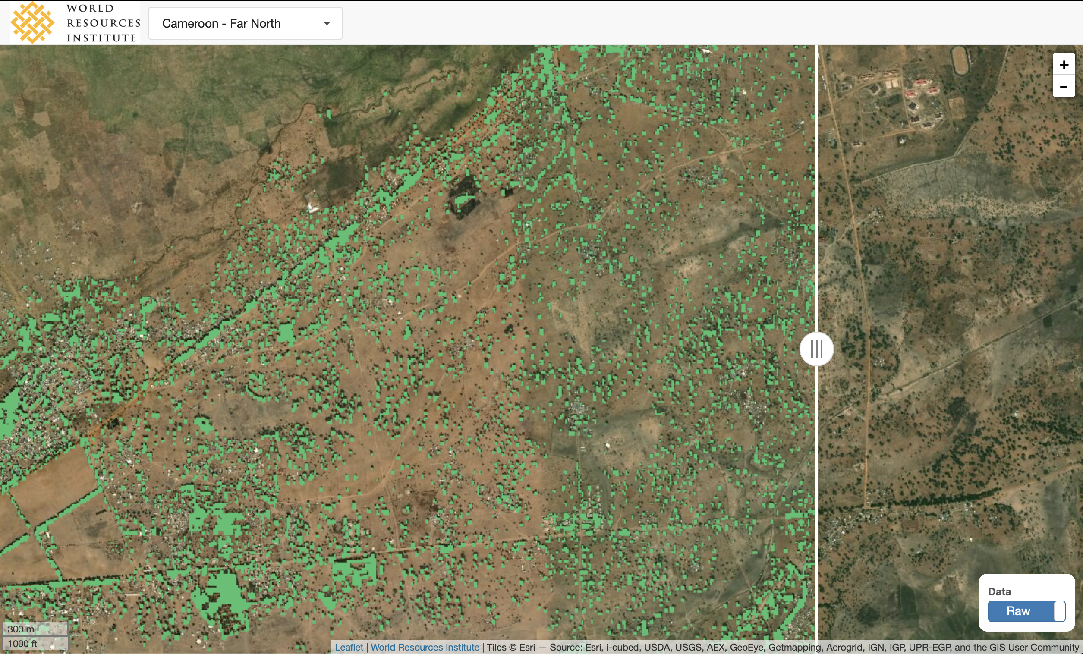
Updates on restoration monitoring
John Brandt

Slide 2
Questions to think about
What other forms of validation do you think are necessary for the method to be believable at a local, regional, and global scale?
How should I compare the results with Hansen data?
Is the ”visual” aspect of the validation clear?
How should I show results versus Bastin 2017?
Who else would you suggest I get comments from?
Where would you like to see this project go?
Towards GFW? Towards GRO? Mastercard? Academic? Country engagement? Local governance?
Funding models? Staffing models?

Slide 3
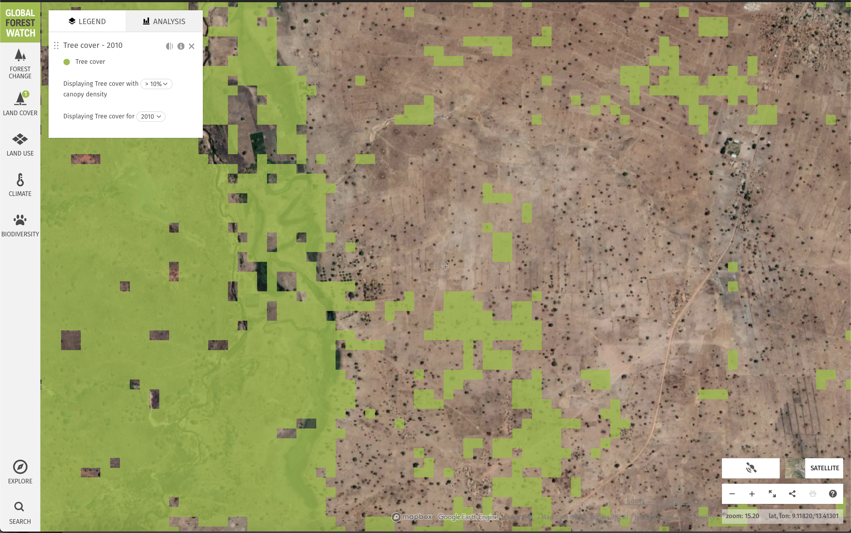
Background
No data or methods for restoration monitoring at scale
GFW data doesn’t get trees outside forests
Bastin paper shows uncertainty around dryland trees
Lots of innovations in the medical field for imagery analysis that can be learned from

Slide 4
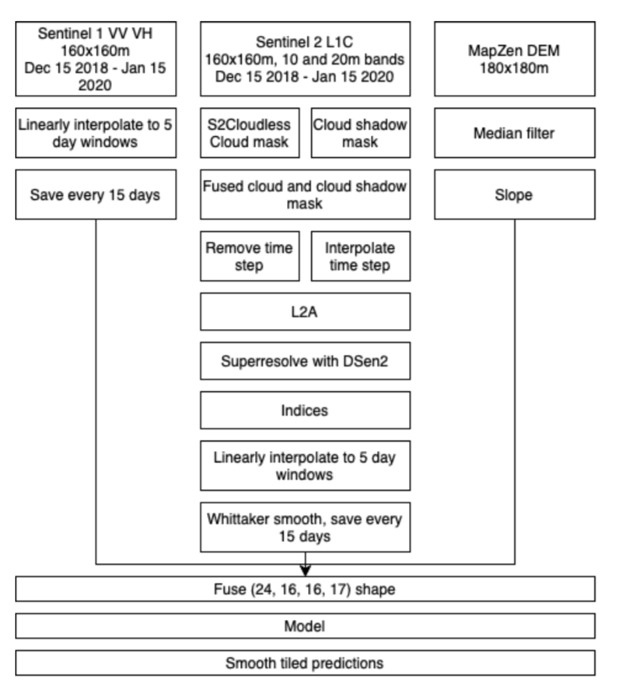
Methods

Slide 5
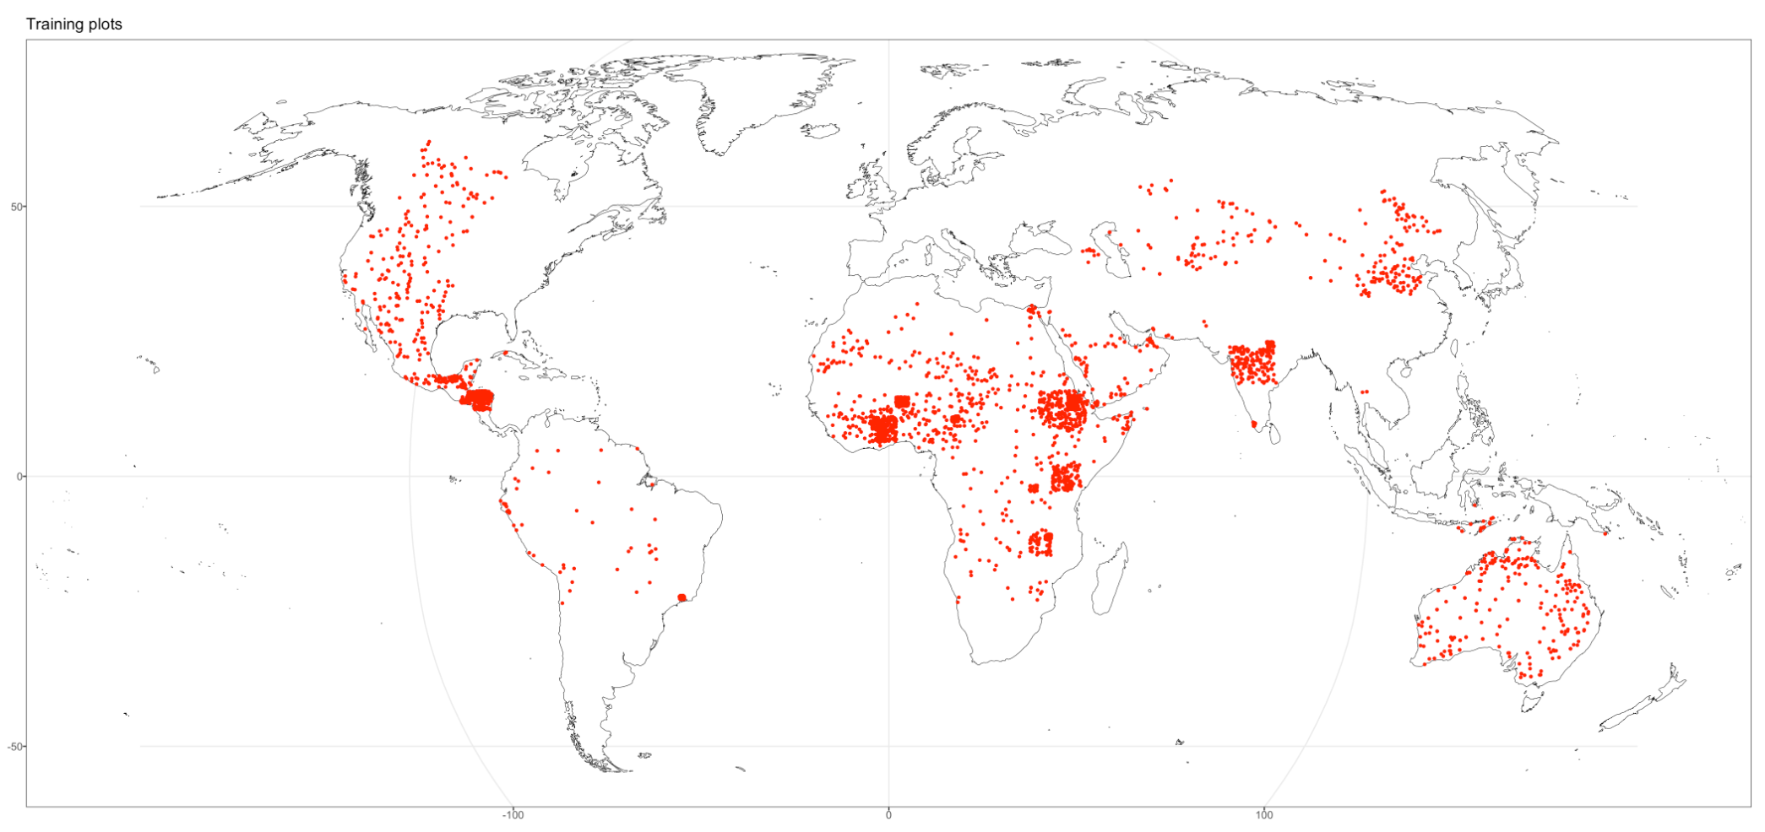
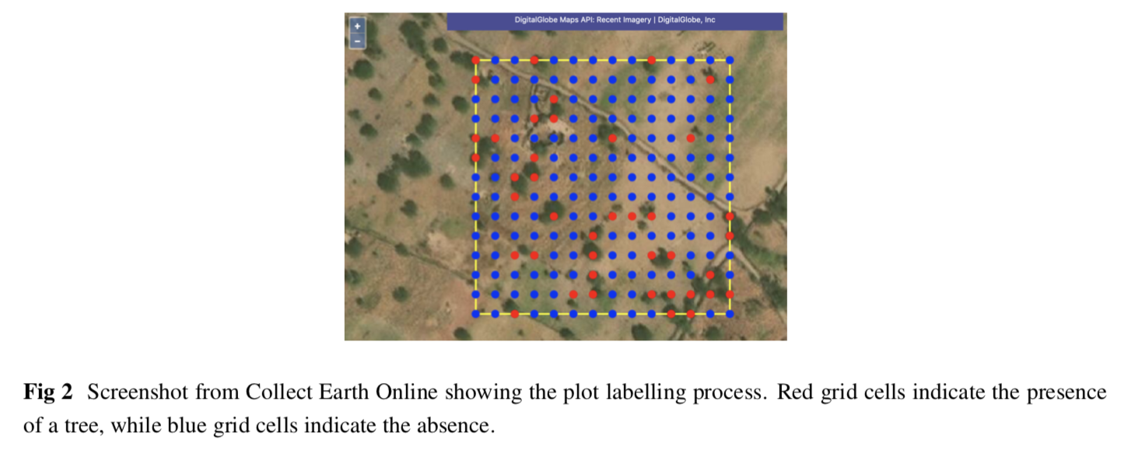
Where does the data come from

Slide 6
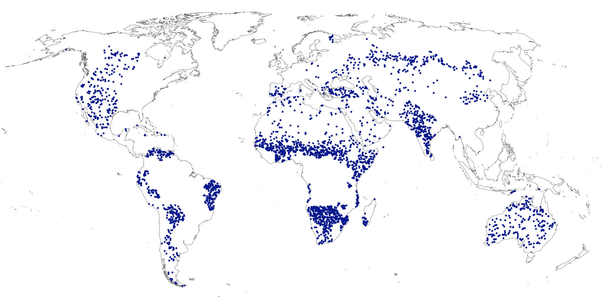
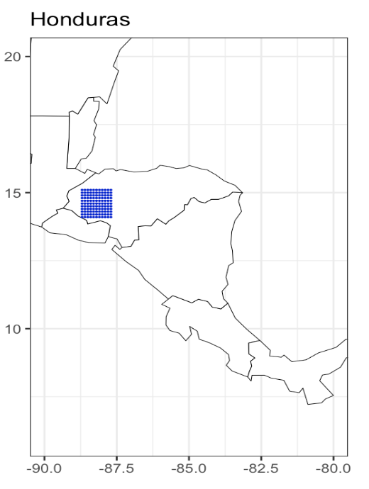
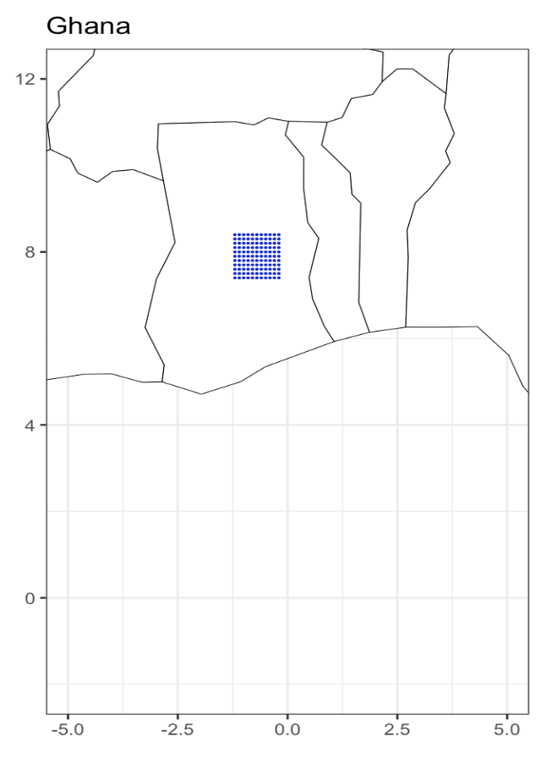
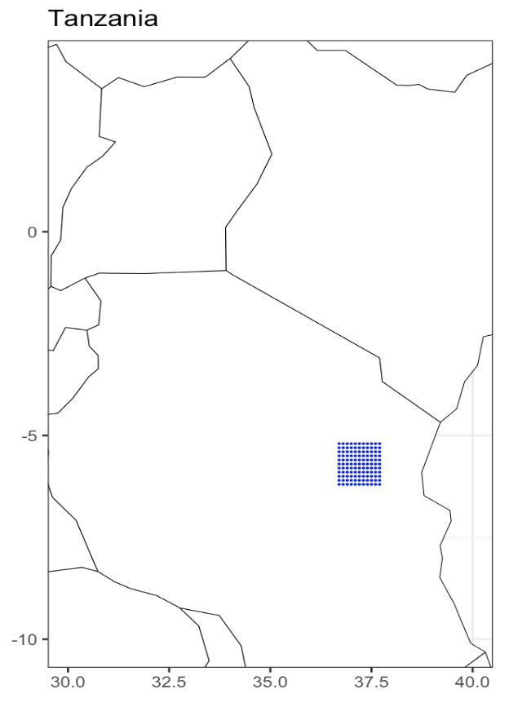
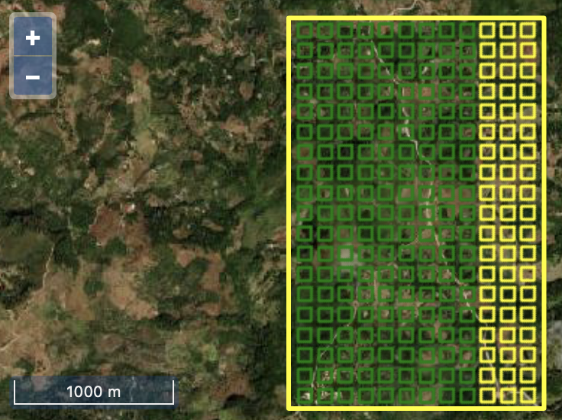
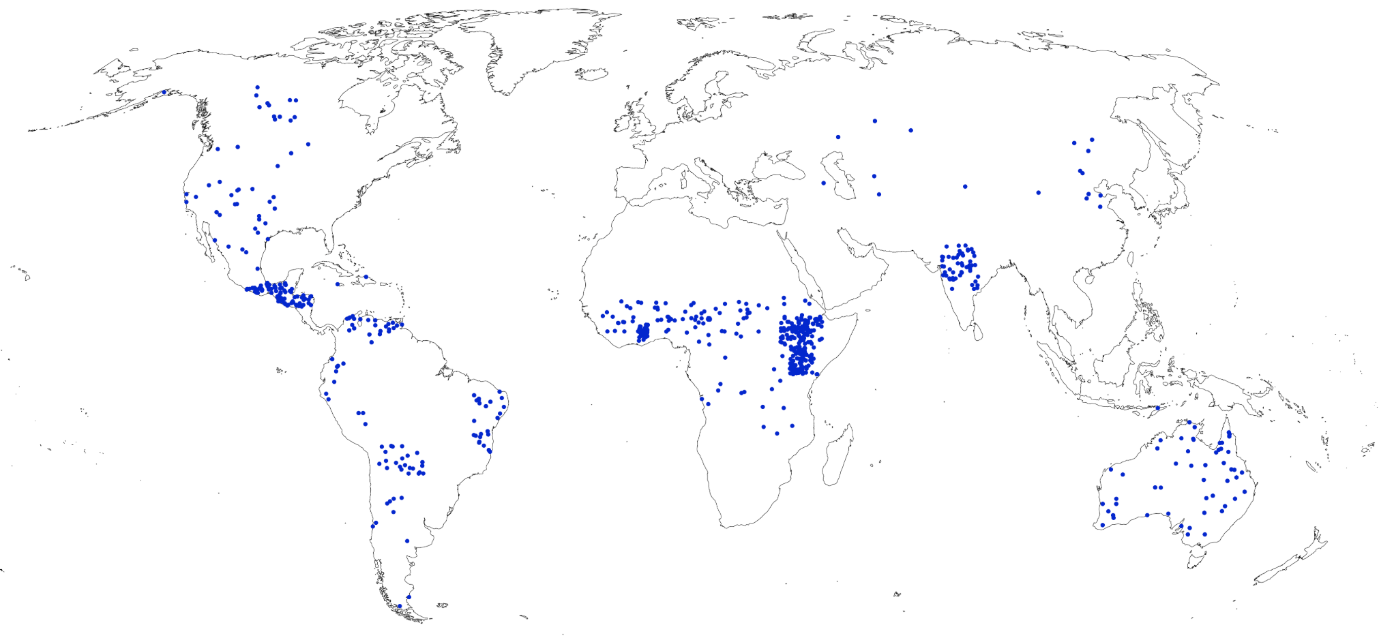
Test data
Global
Regional
Local
& External
data

Slide 7
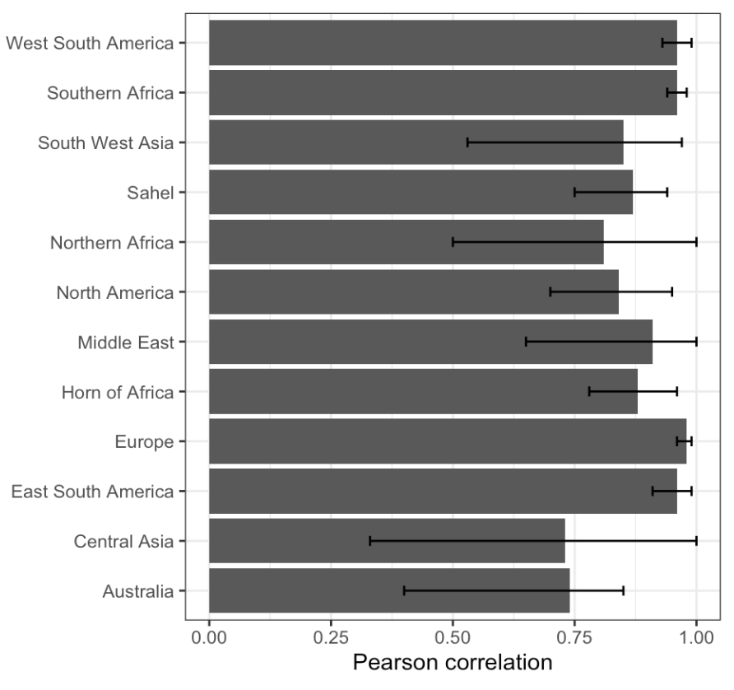
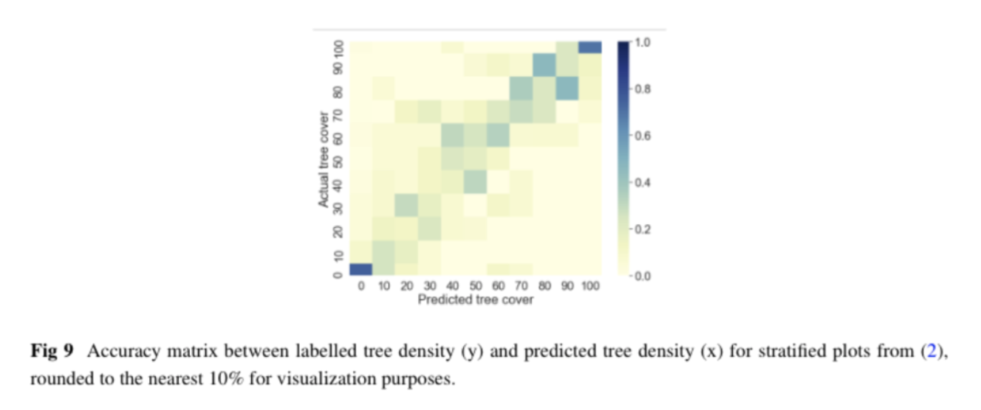

Slide 8
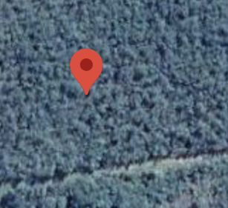
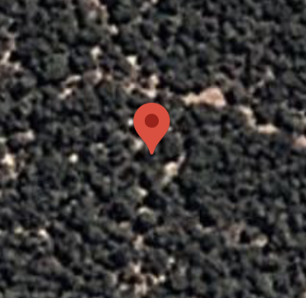
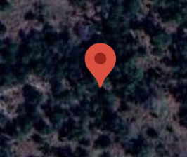
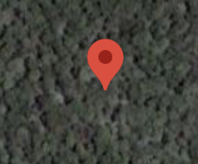
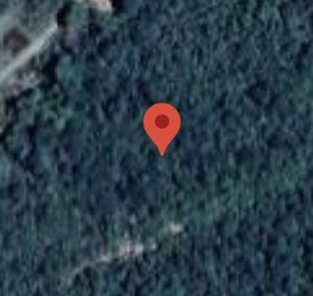
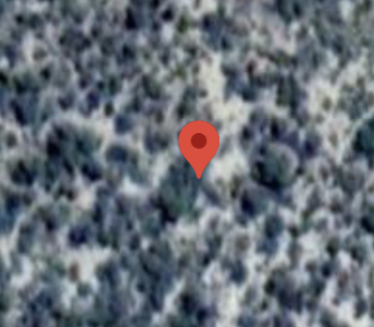
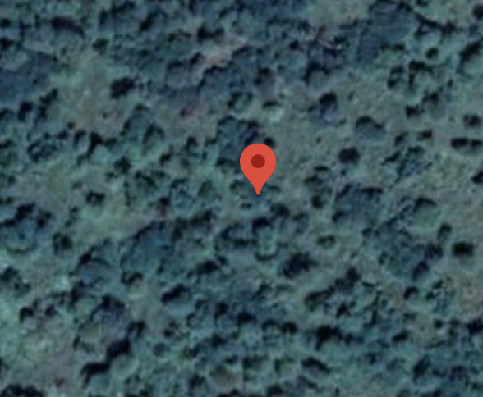
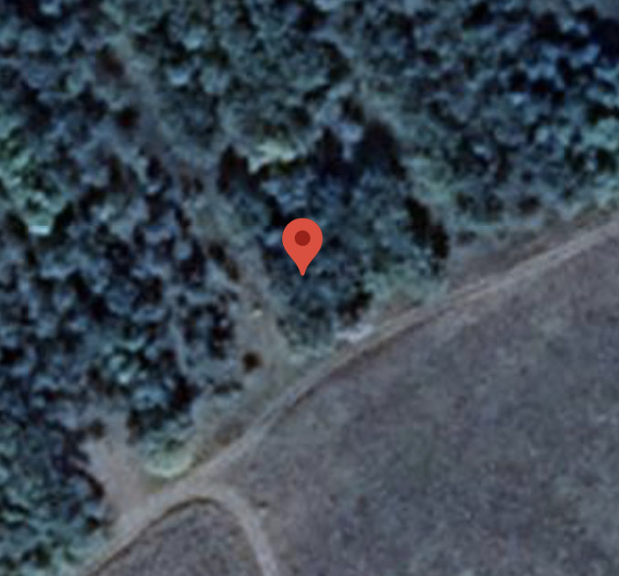
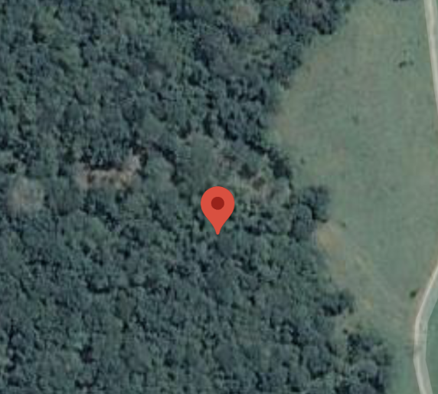
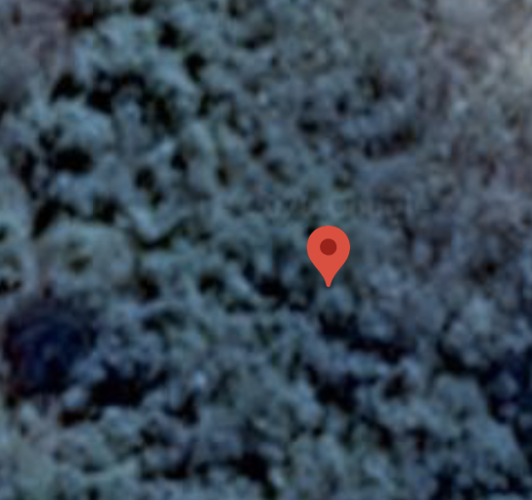
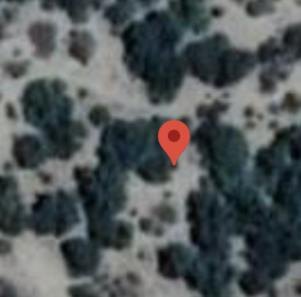
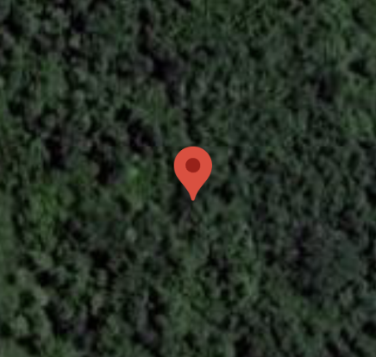
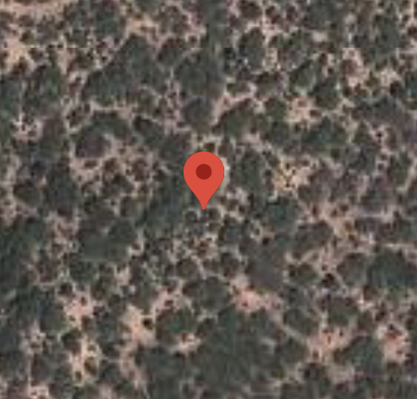
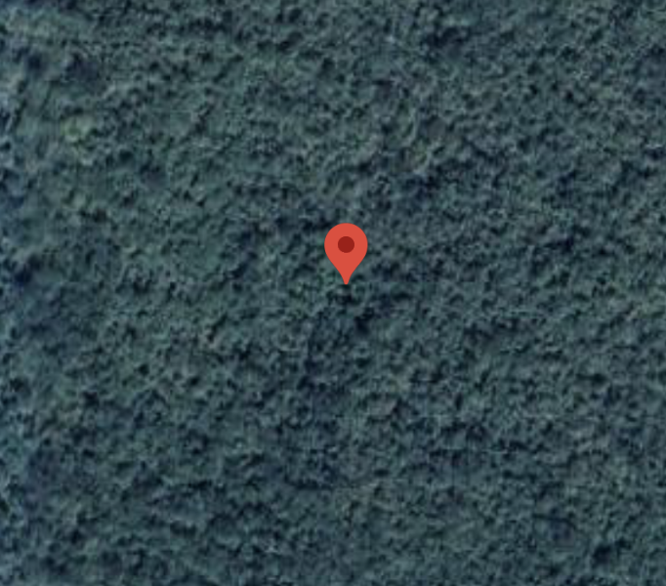
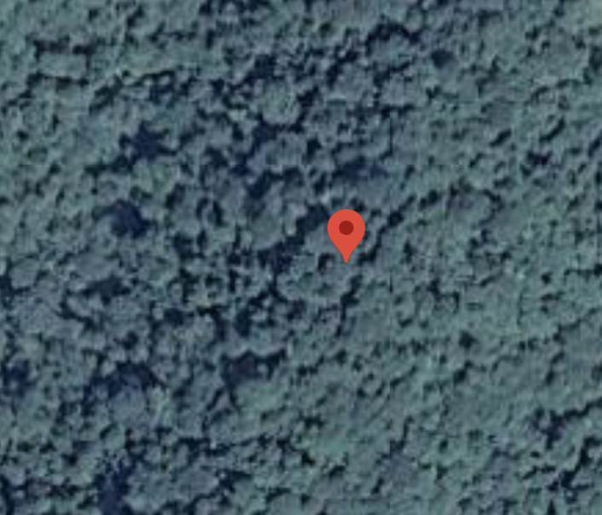
Zero tree cover plots in Bastin 2017

Slide 9
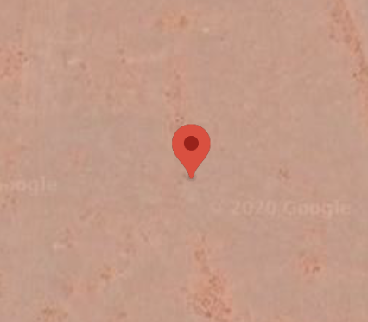
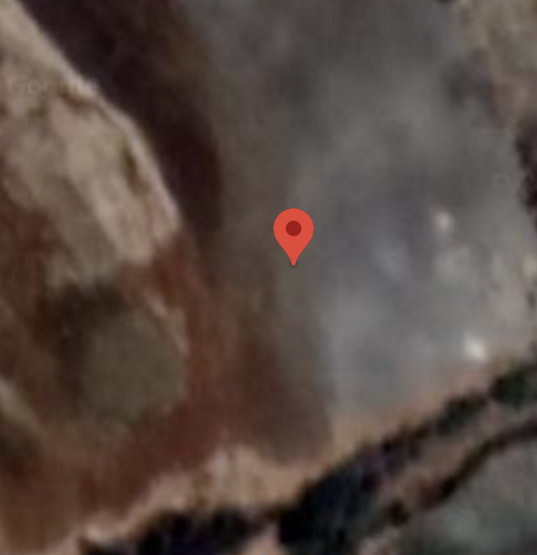
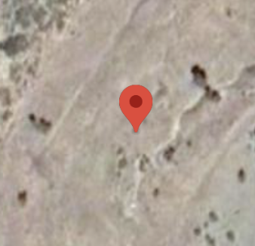
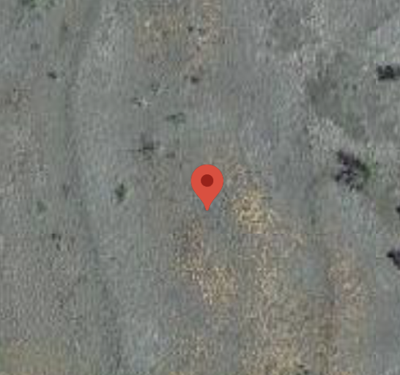
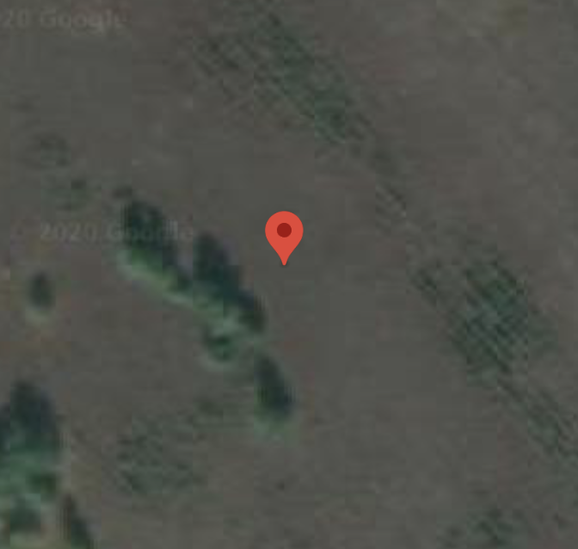
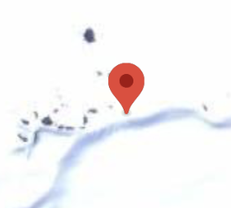
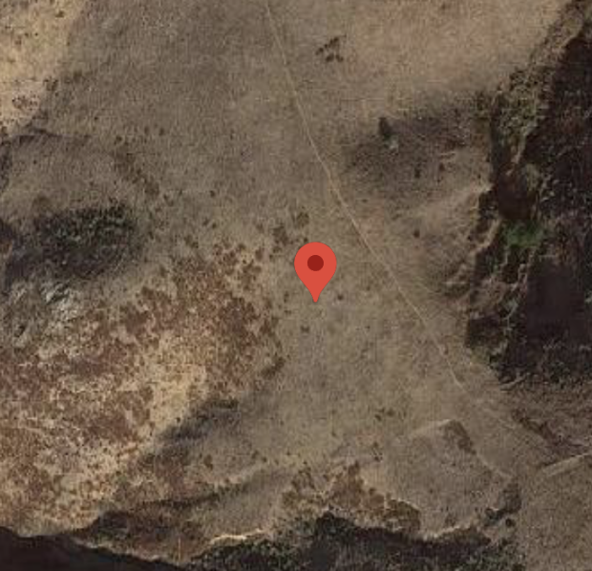
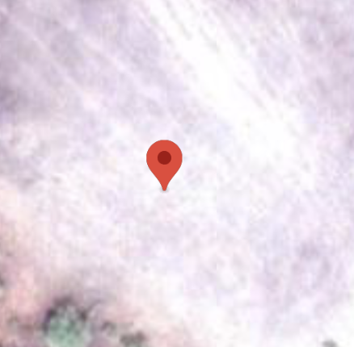
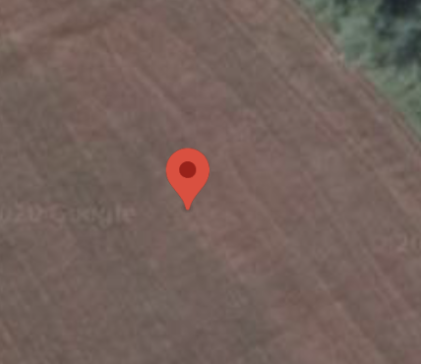
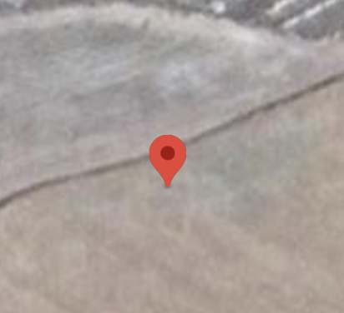
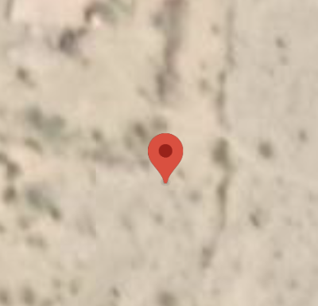
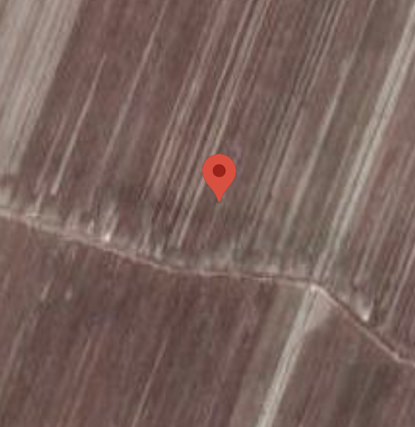
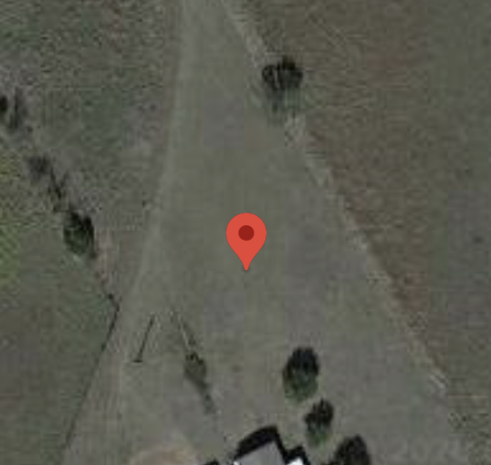
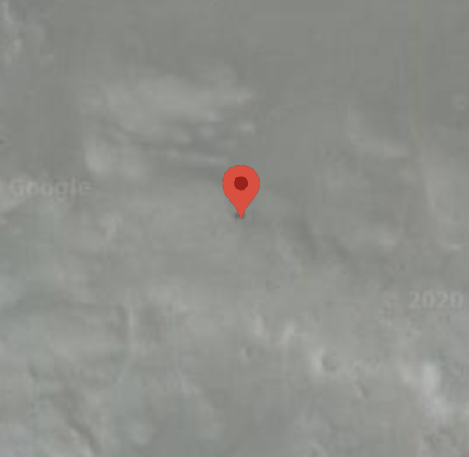
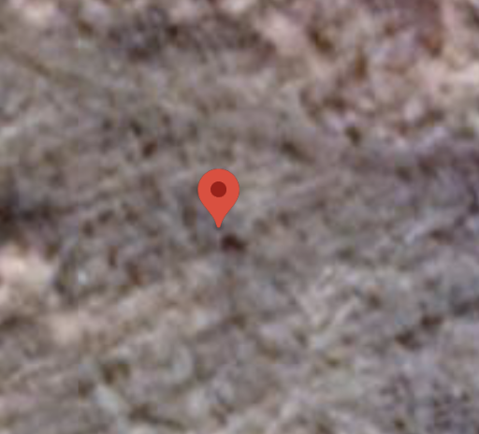
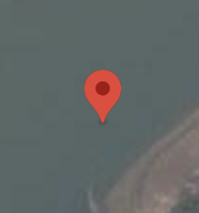
100% tree cover plots in bastin 2017

Slide 10
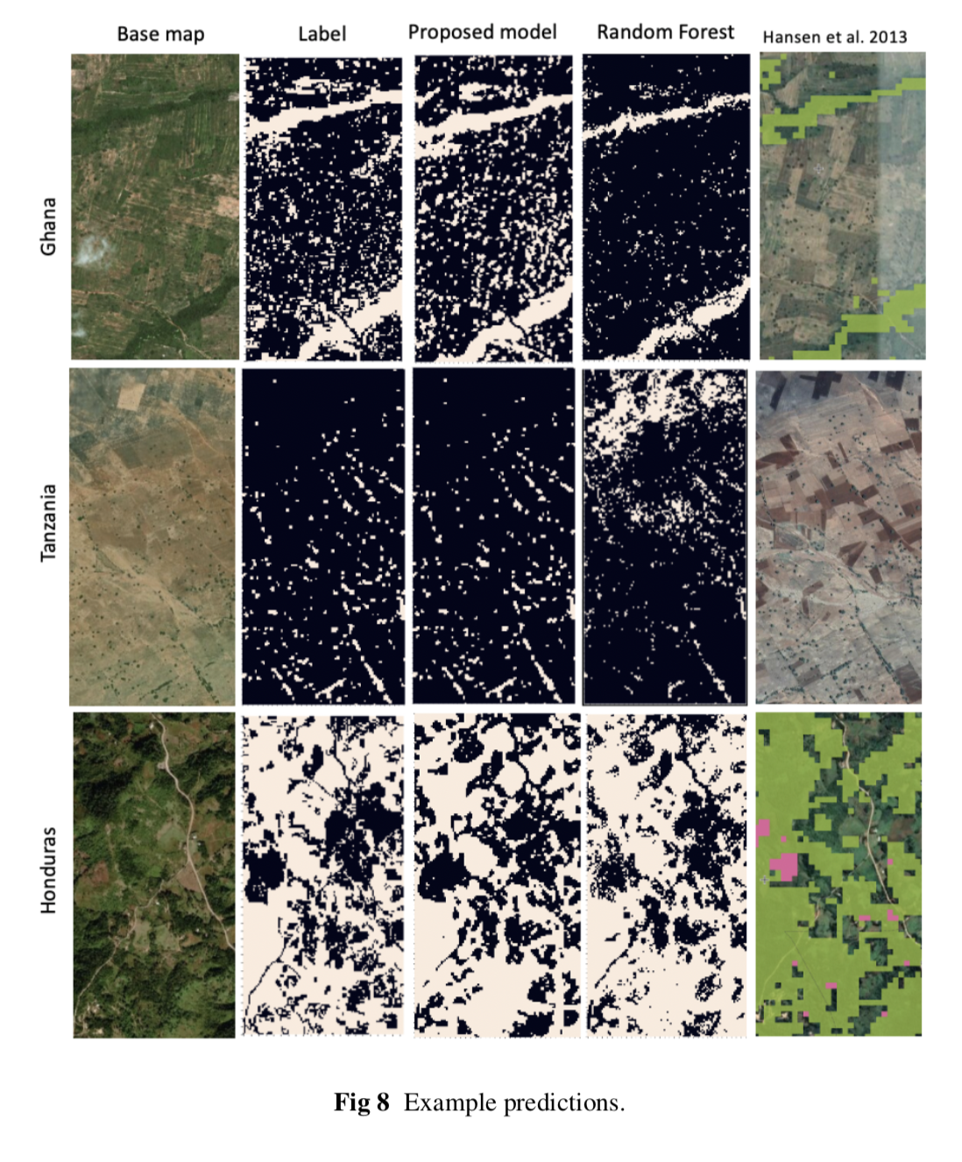
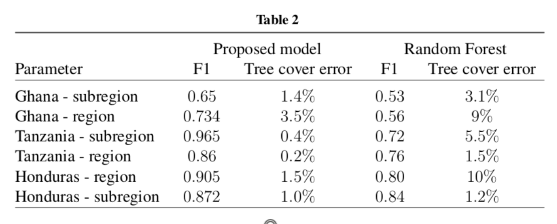

Slide 11
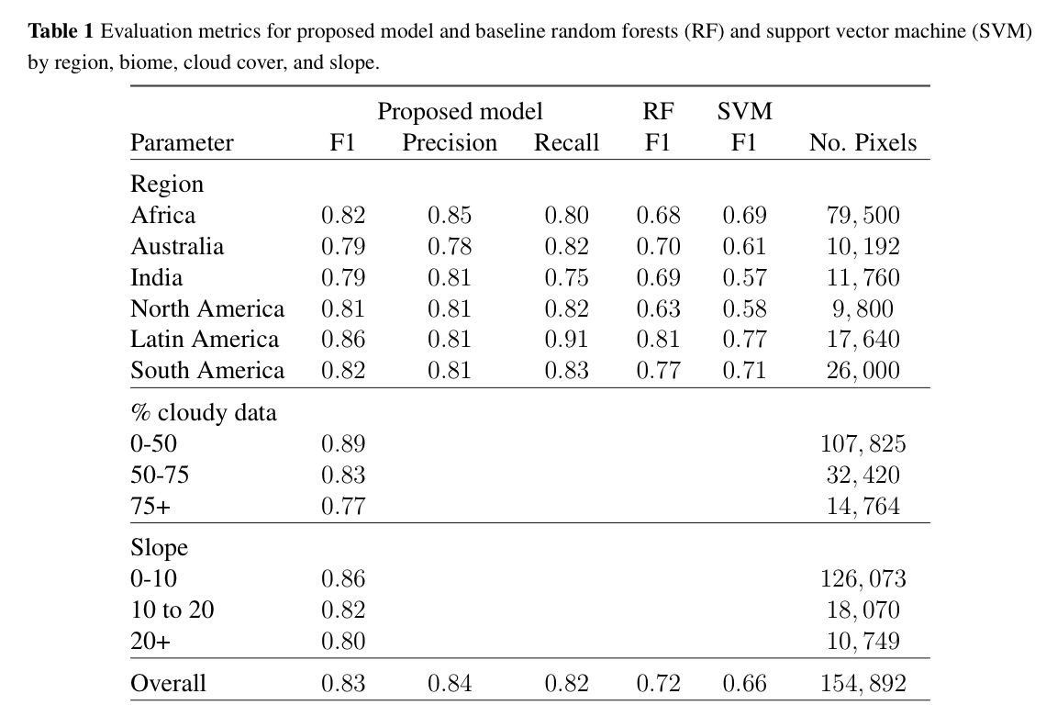
Test data

Slide 12
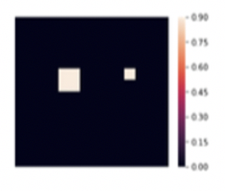
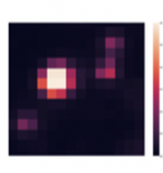
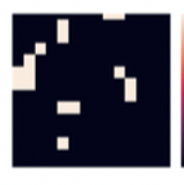





Label
Prediction
Low tree cover
Scattered trees
Medium tree cover
High tree cover

Slide 13

Comparison with Zhang Et al, Oct. 2019 (NASA GODDARD / Compton TUCKER)
Zhang et al. (2019) labelled all their data in Senegal or bordering countries
My approach has zero data labelled in Senegal
My approach detects 85% of trees in this 5000 sq. meter landscape
Zhang et al. identify 31%.

Slide 14

Tested Countries

Slide 15

DRC

Slide 16

DRC

Slide 17

Malawi

Slide 18

MALAWI

Slide 19

MALAWI

Slide 20

Niger

Slide 21

Niger

Slide 22

El SALVADOR

Slide 23

EL SALVADOR

Slide 24

El SALVADOR

Slide 25

Honduras

Slide 26

Honduras - GFW

Slide 27
Recap
Performs better than Bastin 2017 paper for drylands
Performs better than Hansen 2013 data for trees outside forests
Performs better (85 vs 31%) than a regional model of Senegal with the same satellites with no labelled data in Senegal
Visually consistent across 5 million + hectares in 25 + countries
Potential huge advancements in global and landscape monitoring of trees

Slide 28
Looking to the future
I am currently doing all of the:
Data labeling
Coding, cloud infrastructure
Back end, front end
Remote sensing and AI development
Country engagement
Paper writing
Validation
Comparison with other papers
Currently no dedicated funding
Using monitoring money from BMU / BMZ, but tied to landscapes (Cameroon, Niger, Malawi)
Starting work with Ghana GEF 7 project for M&E framework
Funding priority for Sean
Change detection, agroforestry and riparian zone detection, natural regeneration

